Slide 1
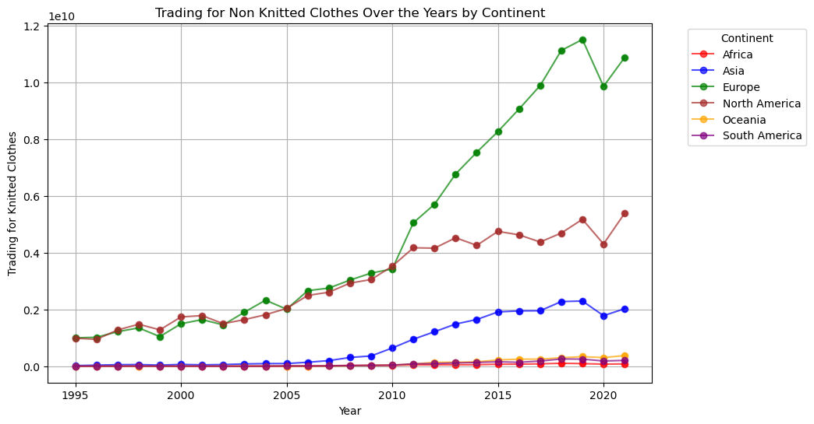

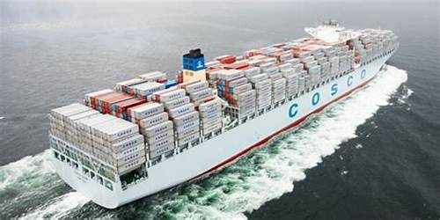
Data Science
1. Prangon 2. Maiwand 3. Salam
Bangladesh’s Exports: Analysis of Trends and Affecting Factors
Group Members

Slide 2

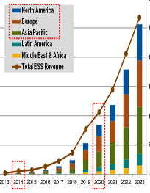
Introduction
Research Qs & Motivation
OUR
AGENDA
Data Processing
Data Visualization
Discussion
Conclusion

Slide 3
INTRODUCTION
Exports play an important role in the growth of countries, especially emerging countries that lack infrastructure, are impacted by dynamic phenomena like disasters, political upheavals, & global developments.
Trade is crucial for Bangladesh's economic success, poverty alleviation, and overall prosperity.
In the past few decades, Bangladesh has made significant progress in its trading sector, while concurrently facing challenges such as natural calamities like floods, the COVID-19 pandemic, and political upheavals.

Slide 4
OUR
MOTIVATION
This research project aims to provide a comprehensive overview of Bangladesh's exports to European, Asian, African, and American nations.
It also emphasizes the key factors that have played a significant role in the country's exports.
By examining influential aspects from 1995 to 2021, we will gain a better understanding of the determinant variables.
This understanding will assist us in policymaking, investment, business decisions, and mitigating potential challenges in the future

Slide 5
To what extent do natural disasters impact Bangladesh's trade?
How do political changes, both domestically and internationally, influence Bangladesh's export sector?
What are the main exported items from Bangladesh between 1995 and 2021?
Who are the primary importers of Bangladesh's trade?
RESEARCH QUESTIONS

Slide 6
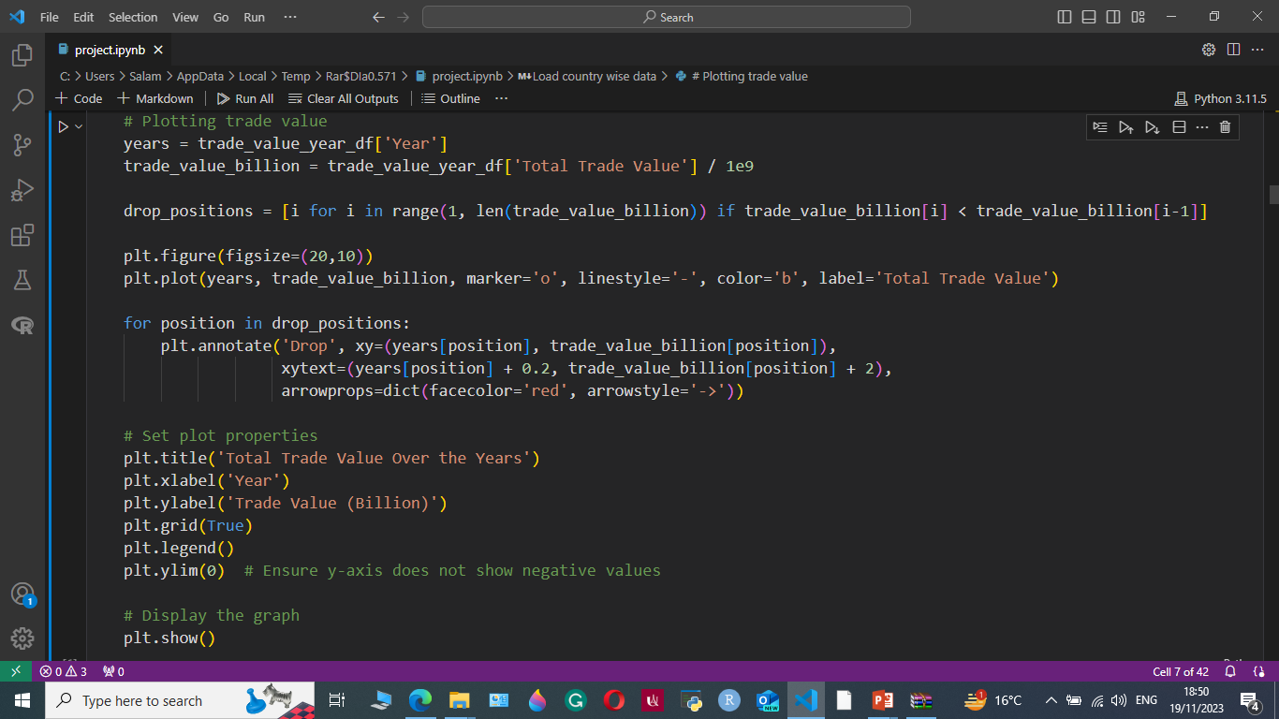
DATA
PROCESSING
27 YEARS (1995-2021)
Knitted Clothing Accessories
Non-Knitted Clothing Accessories
Used Clothes & Textile Articles
Vegetables, Textile Fiber
Notes:
Photo credit: https://pixabay.com/photos/workplace-team-business-meeting-1245776/

Slide 7
DATA
PROCESSING
The data was downloaded from OEC website
Processed through Python (V 3.10) software
Data Cleaning
Data Sorting
Coding
Etc.

Slide 8
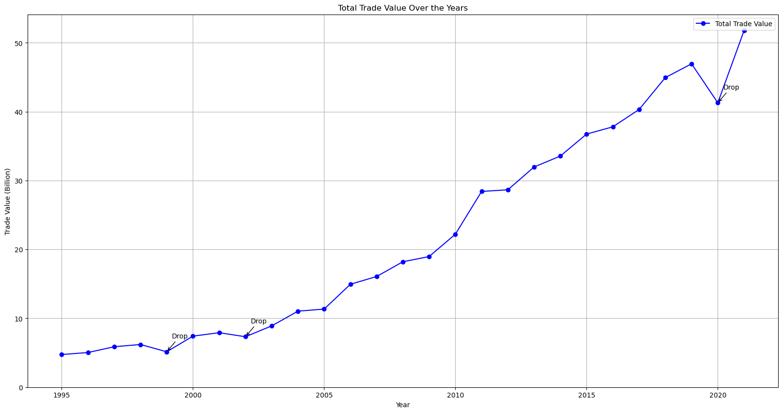

Slide 9
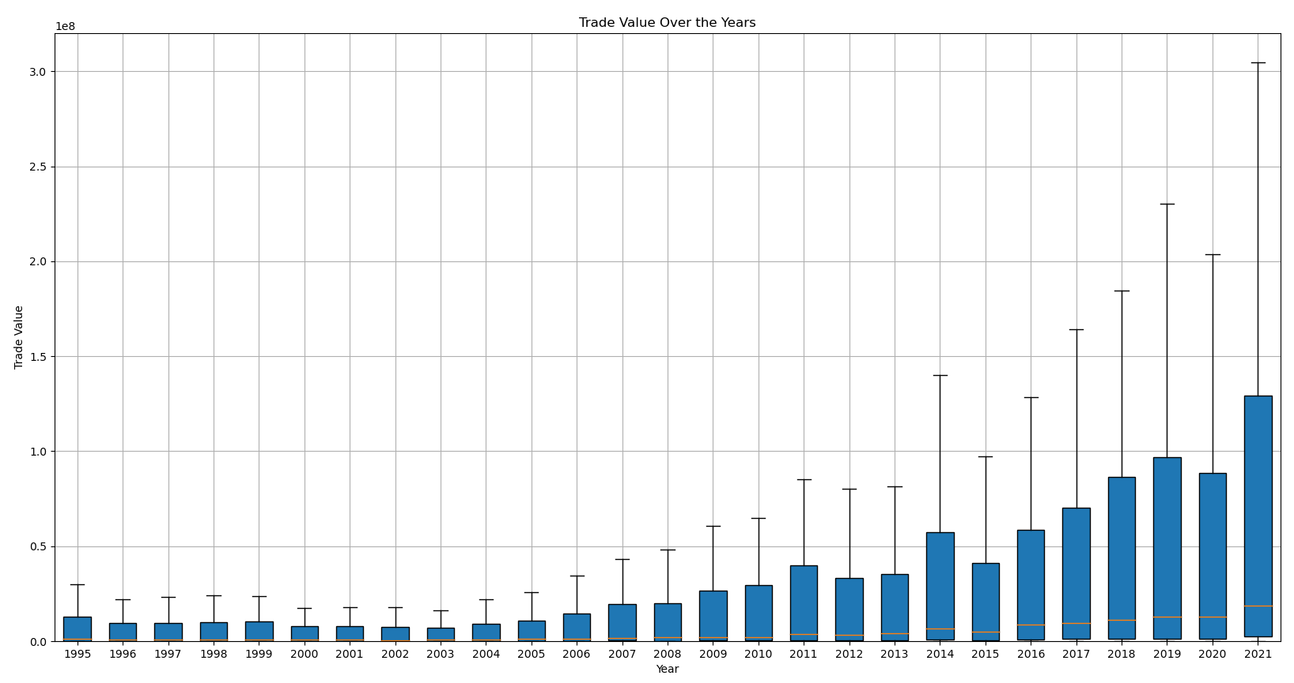

Slide 10
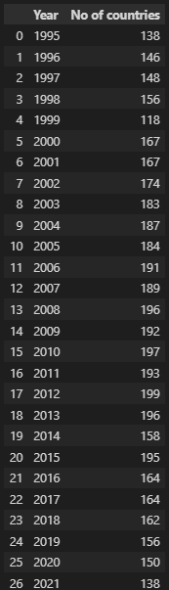
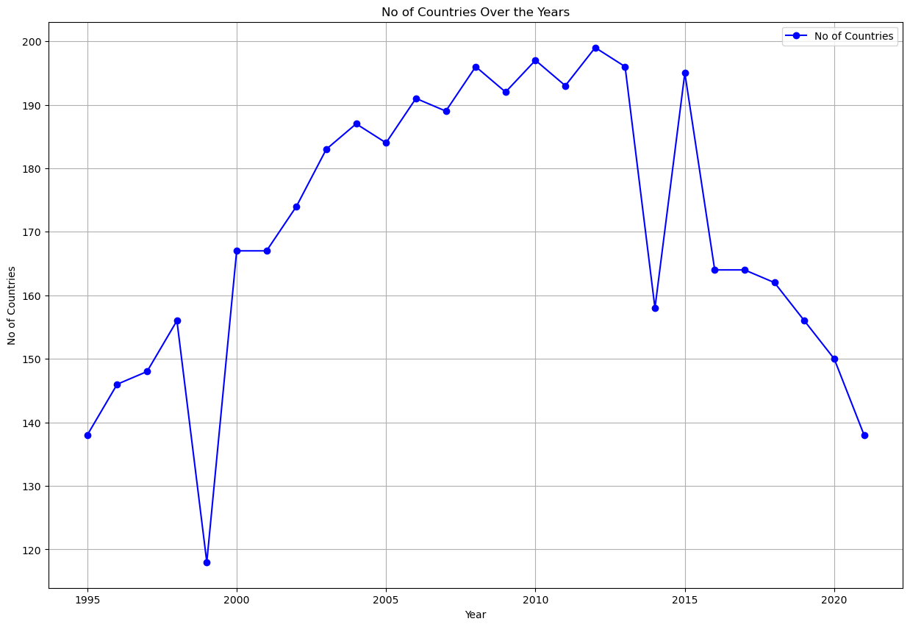

Slide 11
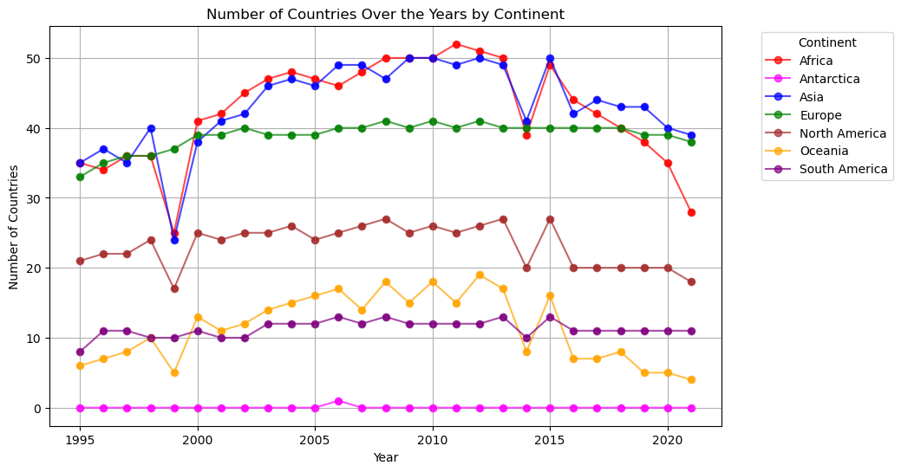

Slide 12
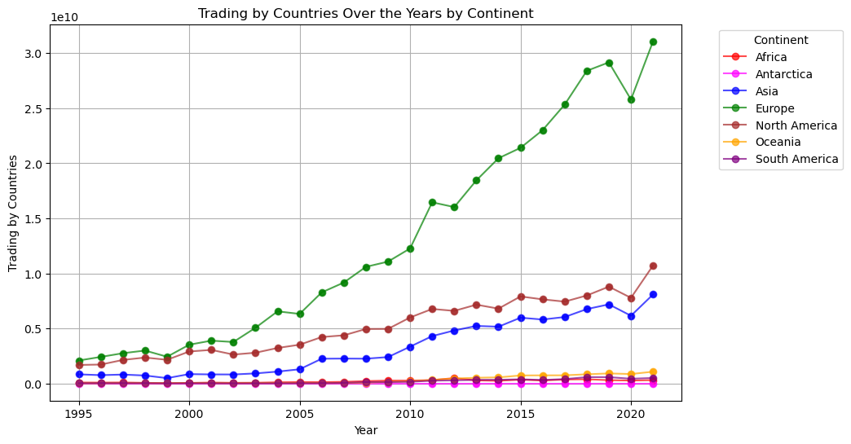

Slide 13
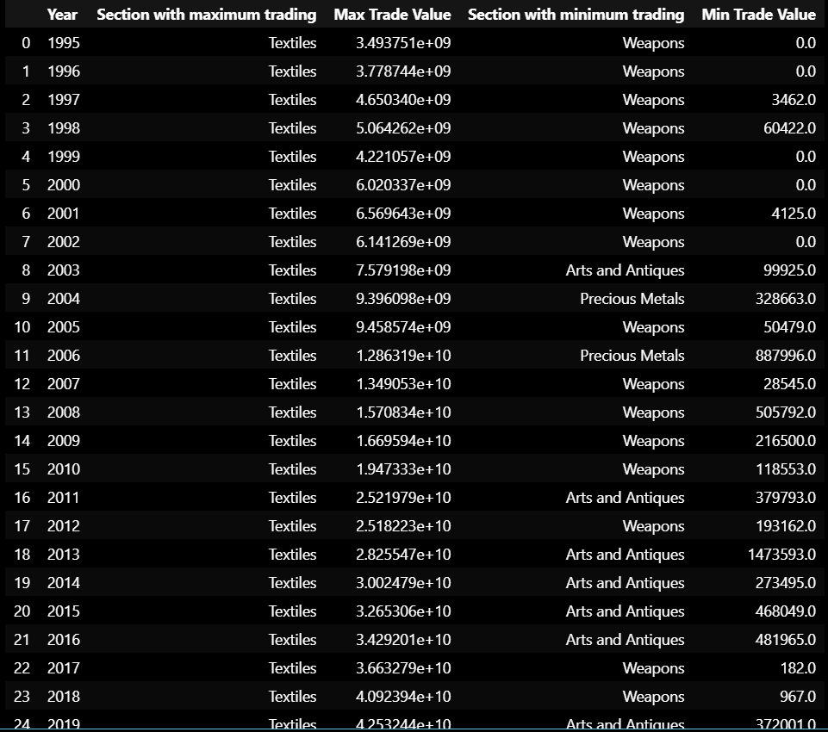
Businesses with
maximum and
minimum Trading
Value in Bangladesh

Slide 14
DATA
VISUALIZATION
27 YEARS (1995-2021)
Knitted Clothing Accessories
Non-Knitted Clothing Accessories
Used Clothes & Textile Articles
Vegetables, Textile Fiber
Notes:
Photo credit: https://pixabay.com/photos/workplace-team-business-meeting-1245776/

Slide 15
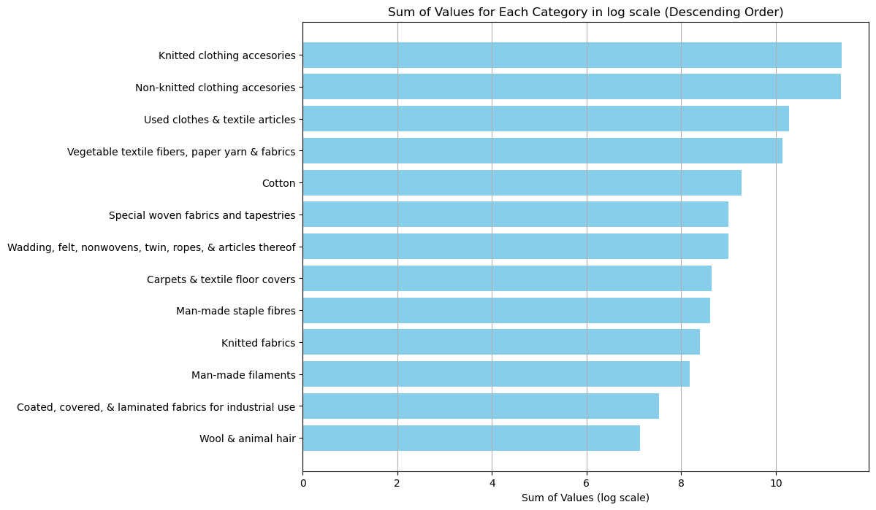

Slide 16
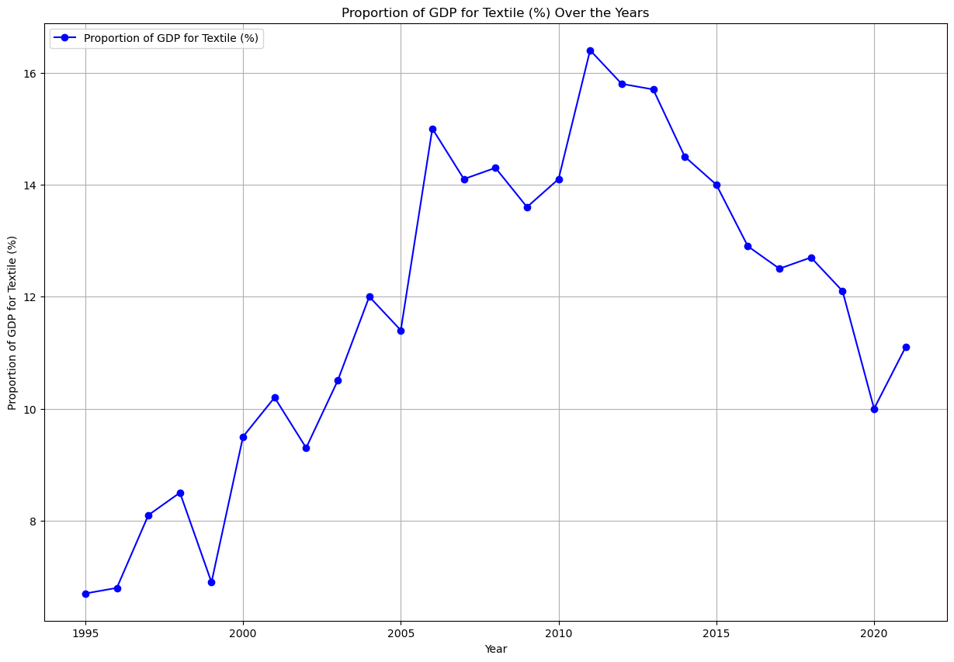

Slide 17
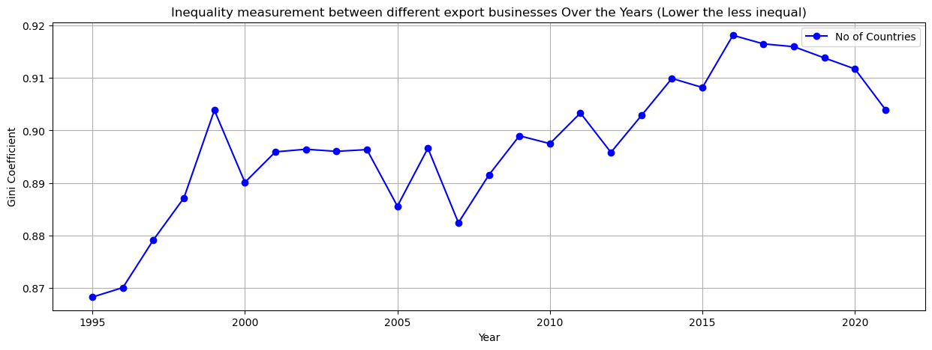
Inequality analysis for the export businesses in Bangladesh:

Slide 18
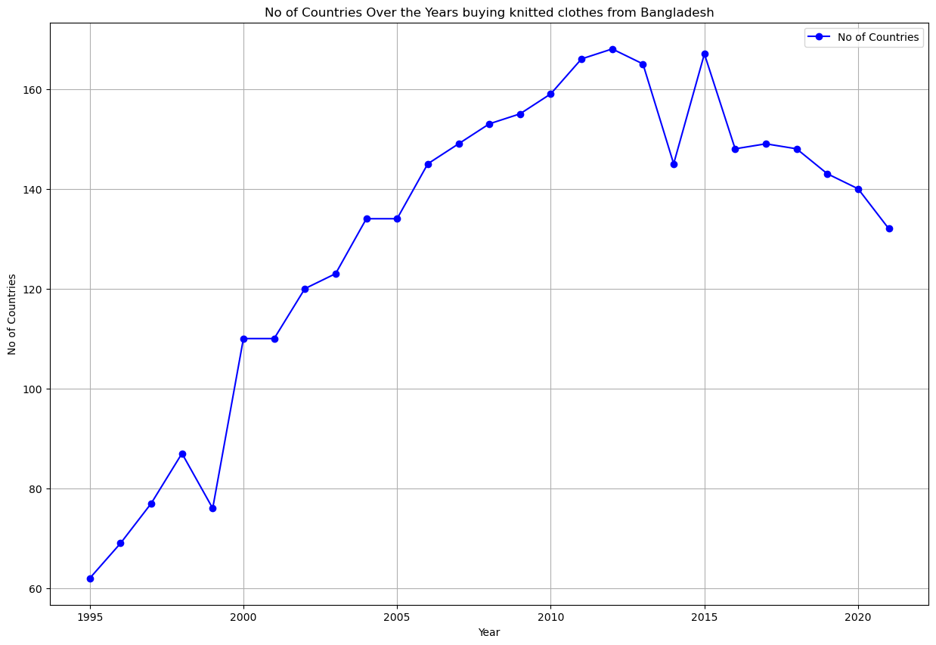

Slide 19
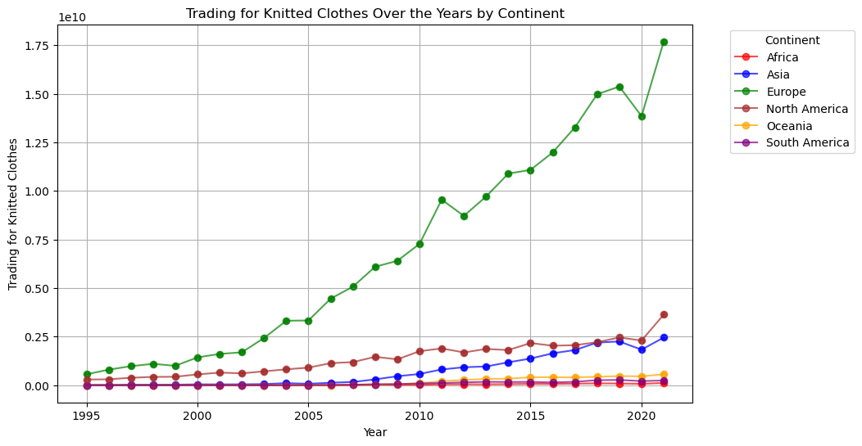

Slide 20
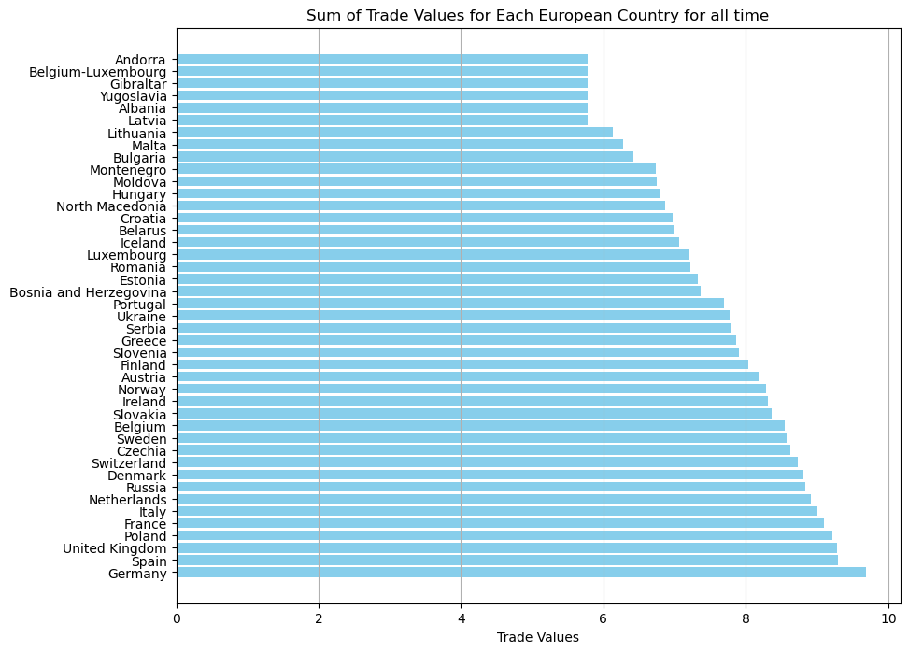
(Log scale)

Slide 21
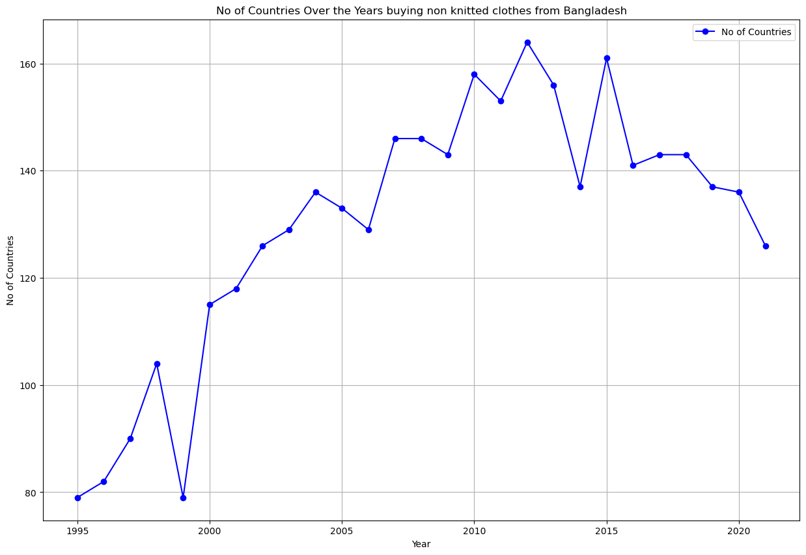

Slide 23

(Log scale)

Slide 24
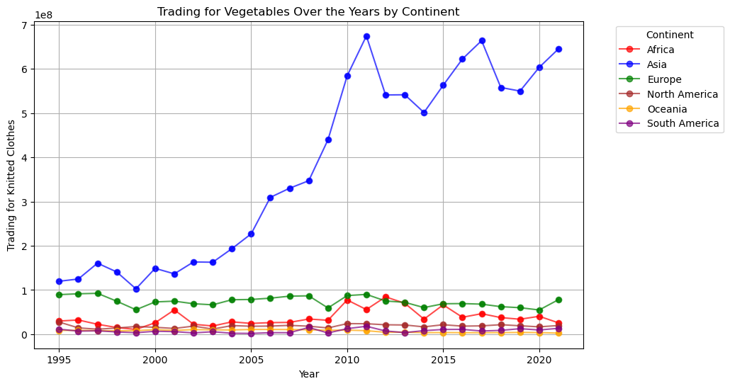

Slide 25
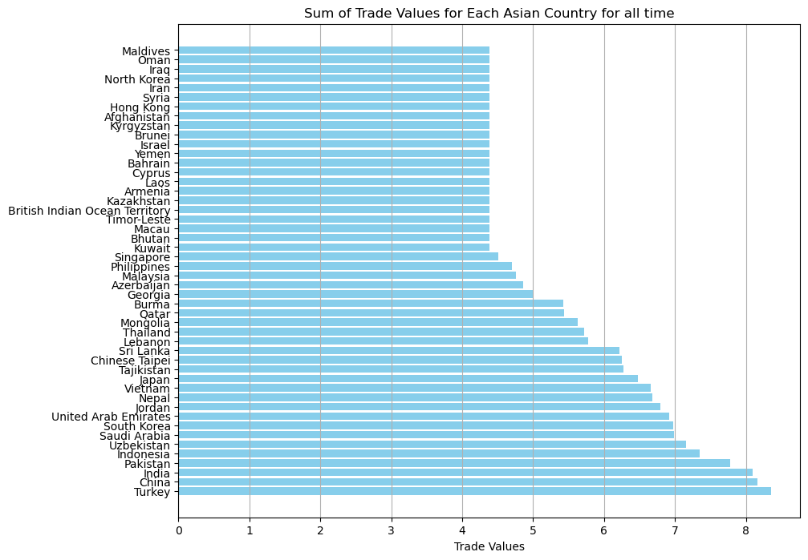
(Log scale)

Slide 26
Countries with different mean trading
values over 27 years

Slide 27
DISCUSSION
Notes:
Photo credit: https://pixabay.com/photos/workplace-team-business-meeting-1245776/

Slide 28
DISCUSSION
The current research project on "Analysis of Bangladesh Export trends and factors affecting them" holds paramount significance due to various key aspects:
1. Economic Growth and National Development: Bangladesh heavily relies on its export sector for economic growth, poverty reduction, and overall national development. The infographics discussed earlier supports this notion very strongly.
2. Impact of Dynamic Phenomena: The country faces various dynamic phenomena, including natural calamities, political changes, and global developments, which significantly affected its export sector. Analyzing these impacts is vital for implementing adaptive measures and ensuring resilience in the face of such challenges.

Slide 29
DISCUSSION
3. Policy Formulation and Decision Making: The comprehensive overview of Bangladesh's exports to diverse regions coupled with the analysis of influential factors from 1995 to 2023 aid policymakers, investors, and businesses in making informed decisions, formulating effective policies, and strategizing for future challenges.
4. Building on Previous Research: While prior studies have delved into specific aspects of Bangladesh's trade, this research project aimed for a more expansive examination. It synthesizes and builds upon previous research findings, widening the scope to encompass various factors influencing export dynamics.

Slide 30
DISCUSSION
5. Identification of Dominant Contributors: Previous studies have identified the ready-made garments (RMG) industry as a significant contributor to Bangladesh's export earnings. This research extends beyond this singular focus to explore a wider range of factors impacting exports, including the influence of natural disasters, political changes, and market dynamics.
6. Trade Potential and Untapped Opportunities: The research underscored the untapped trade potential of Bangladesh, highlighting the need for addressing transaction costs and trade barriers. Understanding these impediments helps in devising strategies to maximize trade potential and explore new markets.

Slide 31
DISCUSSION
7. Global Trade Dynamics: By focusing on trade relationships with different continents, the study sheds light on Bangladesh's global trade dynamics. This broader perspective aids in understanding the country's position in the global market and its trade patterns with various economies.
8. Answering Crucial Research Questions: The research addresses pivotal questions concerning the impact of natural disasters, the influence of political changes, primary importers, and major exported items. These answers provide a nuanced understanding crucial for policymakers and stakeholders.

Slide 32
CONCLUSION
Bangladesh has a lot of potential for its production of textile exports
New markets and buyers are to explored and accessed to optimize the benefits
There is great opportunity to add to the country’s GDP, FDI and FE

Slide 33
CONTRIBUTIONS
Maiwand
Introduction
Research Qs
Literature Review
Prangon
Data Acquisition & Processing
Coding, Cleaning, Sorting
Data Visualization
Salam
Presentation Design
Discussion & Conclusion
Report Writing

Slide 34
REFERENCES
Arjuman Ara, L., & Rahman, M. (2019). The Competitiveness and Future Challenges of Bangladesh in International Trade. Researh Gate .
Dorosh, P., & Rashid, S. (2013). Trade subsidies, export bans and price stabilization: Lessons of Bangladesh–India rice trade in the 2000s. International Food Policy Research Institute,, 103-111.
Hasan, F., Mia, S., zaman, A., Rahman, M., Ullah, A., & Sharia Ullah, M. (2016). Role of Textile and Clothing Industries in the Growth and Development of Trade & Business Strategies of Bangladesh in the Global Economy. International Journal of Textile Science, 39-48.
Hussain, M., & Haque, M. (2021). Foreign Direct Investment, Trade, and Economic Growth: An Empirical Analysis of Bangladesh. MDPI.
Islam, R., Chowdhury, S., Rahman, S., & Zayed, N. (2021). An Analysis of the Detrimental Effect of COVID-19 pandemic: A study in Bangladesh. Journal of Humanities, Arts and Social Science, 2, 116-124.
Mohammad Mafizur, R. (2008). The foreign trade of Bangladesh: its composition, performance, trend, and policy. Journal of Bangladesh, 26-37.
Ninno, C., Dorosh, P., & Islam, N. (2002). Reducing Vulnerability to Natural disasters : Lessons from the 1998 floods in Bangladesh. IDS Bulletin .
Rahman, M., & Arjuman Ara, L. (2010). Bangladesh trade potential: a dynamic gravity approach. Journal of International Trade Law and Policy.
Raihan, S., & Mahmud, N. (2008). Trade and Poverty Linkages A Case Study of the Poultry Industry in Bangladesh. Cuts Citee Working Paper.
Roy, M., & Rayhan, I. (2011). Trade Flows of Bangladesh: A Gravity Model Approach. Economics Bulliten.

Slide 35

QUESTIONS
THANK YOU
Notes:
You can safely remove this slide. This slide design was provided by SlideModel.com – You can download more templates, shapes and elements for PowerPoint from http://slidemodel.com/

